Slide 1
Brain Tumour Segmentation
BY
DEEPAK SRINIVAAS
VISHNU NAGARAJ

Slide 2
ABSTRACT
This paper deals with the implementation of Simple Algorithm for detection of range and shape of tumour in brain MR images.
Brain tumour is inherently serious and life-threatening because of its character in the limited space of the intracranial cavity (space formed inside the skull.)
CT scan or MRI that is directed into intracranial cavity produces a complete image of brain. This image is visually examined by the physician for detection & diagnosis of brain tumour.
However this method of detection resists the accurate determination of stage & size of tumour.
uses computer aided method for segmentation (detection) of brain tumor based on the combination of two algorithms.
segmentation of tumor tissue with accuracy and reproducibility comparable to manual segmentation.
reduces the time for analysis.
Finally the tumour is extracted from the MR image and its exact position and the shape also determined.
The stage of the tumour is displayed based on the amount of area calculated from the cluster.

Slide 3
INTRODUCTION
Two algorithms are used for segmentation. So it gives the accurate result for tumor segmentation.
The tumour may be primary or secondary. If it is an origin, then it is known as primary. If the part of the tumour is spread to another place and grown as its own then it is known as secondary. Normally brain tumour affects CSF (Cerebral Spinal Fluid).
Normally tumor cells are of two types. They are Mass and Malignant. The detection of the malignant tumor is somewhat difficult to mass tumor.
For the accurate detection of the malignant tumor that needs a 3-D representation of brain and 3-D analyser tool.
Segmentation is used on detection of mass tumor detection .The developing platform for the detection is mat lab ,because it is easy to develop and execute. At the end, we are providing systems that detect the tumor and its shape.

Slide 4
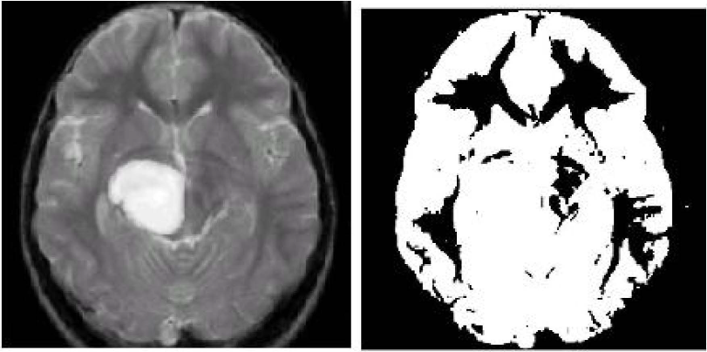
EXISTING METHOD
The existing method is based on the thresholding and region growing. The thresholding method ignored the spatial characteristics. Normally spatial characteristics are important for the malignant tumor detection
But the bit map image contains 0 to 255 grey scale values. sometimes it ignores the tumor cells also.
In case of the region growing based segmentation it needs more user interaction for the selection of the seed. Seed is nothing but the centre of the tumour cells
Fig 1: is the input image for thresholding. From the MR image itself we can see the tumor area but it is not enough for further treatment
Fig 2: It consists of only two grey values .That is white as 1 and black as O. The background value is assigned to binary value 0 and object gets the value 1. So we cannot extract the tumor from the image. This is the main drawback of the existing system.
Fig 1: input image Fig 2 : output image
For thresholding for thresholding

Slide 5
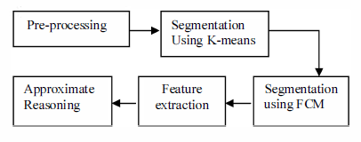
PROPOSED SYSTEM
The proposed system has four main modules :-

Slide 6
PRE PROCESSSING
It performs filtering of noise and other artifacts in the image and sharpening the edges in the image.
RGB to grey conversion and Reshaping also takes place here. It includes median filter for noise removal. The possibilities of arrival of noise in modern MRI scan are very less. It may arrive due to the
thermal effect.
The main aim of this project is to detect and segment the tumor cells. But for the complete system it needs the process of noise removal.
For better understanding of the function of median filter, we added the salt and pepper noise artificially and removing it using median filter.

Slide 7
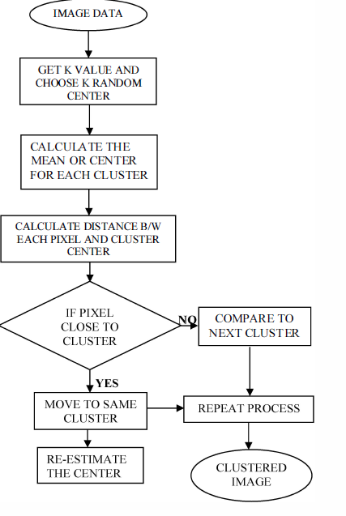
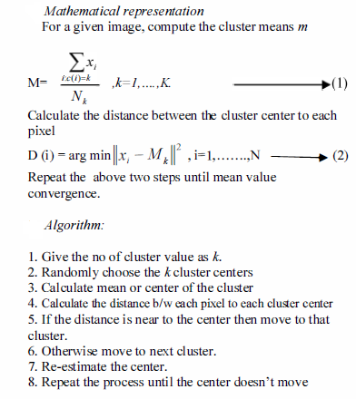
K-Means Algorithm

Slide 8
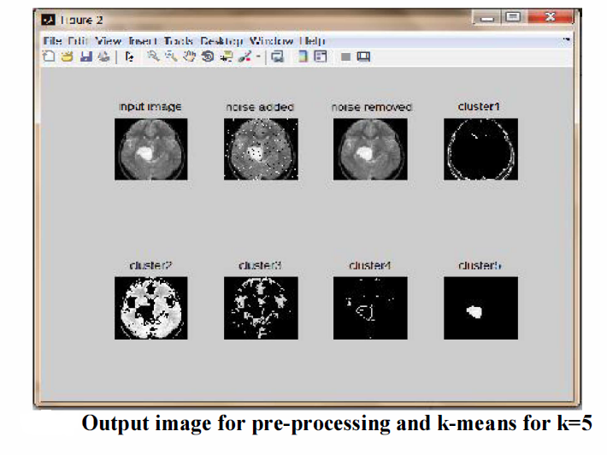
Screen shot for pre-processing and K-means
The MR image given as input to the pre processing and K-means algorithm. Here 0.02% of salt and pepper noise is added and that has been removed using the median filter. The K-mean algorithm clusters the image according to some characteristics. Figure is the output for K-Means algorithm with five clusters. At the fifth cluster the tumor is extracted

Slide 9
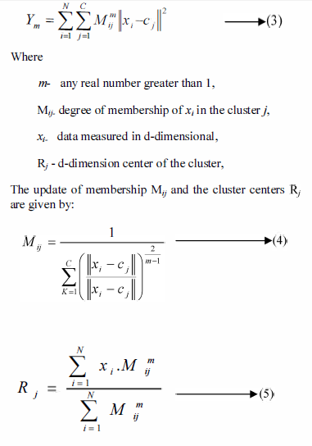
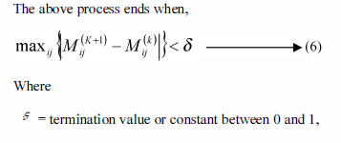
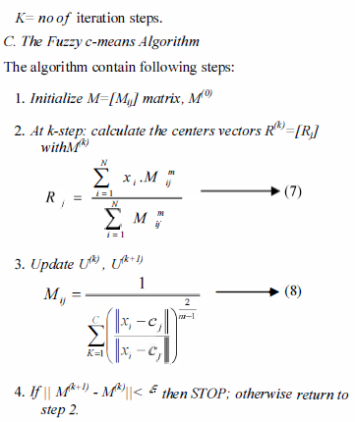
SEGMENTATION USING FUZZY C-MEANS
Mathematical representation
Fuzzy c-means (FCM) is the clustering algorithm which allows one piece of data may be member of more than one clusters. It is based on reducing the following function

Slide 10
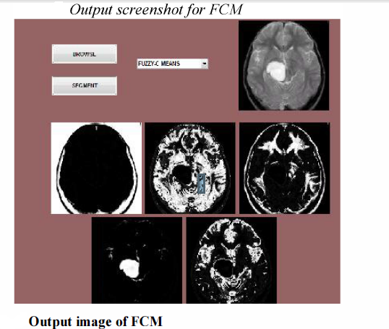
The output image for Fuzzy C Means. It is mainly developed for the accurate prediction of tumor cells which are not predicted by K-means algorithm. It gives the accurate result for that compared to the K-Means.

Slide 11
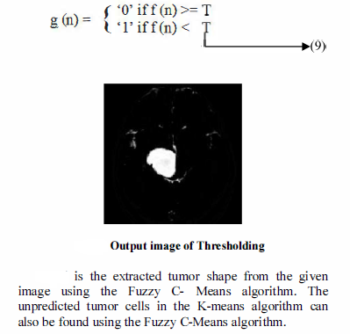
FEATURE EXTRACTION
The feature extraction is extracting the cluster which shows the predicted tumor at the FCM output.
The extracted cluster is given to the thresholding process.
It applies binary mask over the entire image. It makes the dark pixel become darker and white become brighter.

Slide 12
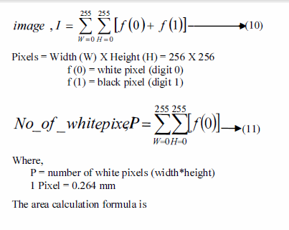
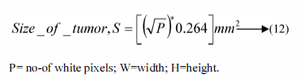
APPROXIMATE REASONING
Mathematical representation
Algorithm
Step 1: Start the process.
Step 2: Get the MRI scan image input in JPEG
format.
Step 3: Check whether the input image is in required
format and move to step 4 if not display error
message.
Step 4: If image is in RGB format covert it into gray
scale else move to next step.
Step 5: Find the edge of the grayscale image.
Step 6: Calculate the number of white points In the
image.
Step 7: Calculate the size of the tumor using the
formula.
Step 8: Display the size and stage of tumor.
Step 9: Stop the program.
This algorithm scans the RGB or grayscale image,
converts the image into binary image by binarization
technique and detects the edge of tumor pixels in the
binary image. Also it calculates the size of tumor by
calculating the number of white pixels (digit 0) in binary
image.

Slide 13
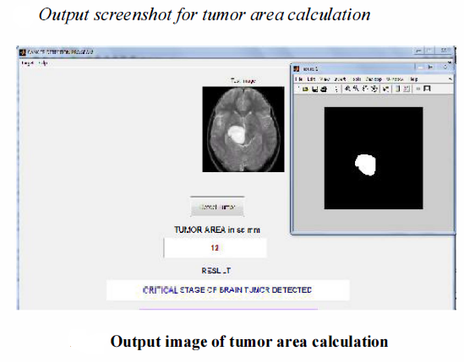
The predicted tumor area is calculated at approximate reasoning step fig shows the output result for tumor area and its stage calculation. The stage of tumor is based on the area of tumor. We considered that, if the area is greater than 6 mm"2 it will be the critical position.

Slide 14
CONCLUSION AND FUTURE WORK
There are different types of tumors are available. They may be as mass in brain or malignant over the brain.
Suppose if it is a mass then K- means algorithm is enough to extract it from the brain cells.
If there is any noise are present in the MR image it is removed before the Kmeans process. The noise free image is given as a input to the k-means and tumor is extracted from the MRI image.
And then segmentation using Fuzzy C means for accurate tumor shape extraction of malignant tumor andthresholding of output in feature extraction.
Finally approximate reasoning for calculating tumor shape and position calculation.
The experimental results are compared with other algorithms.
The proposed method gives more accurate result. In future 3D assessment of brain using 3D slicers with matlab can be developed

Slide 15
REFERENCES
[I]. M.H. Fazel Zarandia, M. Zarinbala, M. Izadi b(2011), "Systematic
image processing for diagnosing brain tumors: A Type-II fuzzy
expert system approach," Applied soft computing 11,285-294
[2]. S.Mary Praveena ,Dr.I1aVennila , June 2010, "Optimization Fusion
Approach for [mage Segmentation Using K-Means Algorithm,"
International Journal of Computer Applications (0975 - 8887)
Volume 2 - NO.7.
[3]. M. Masroor Ahmed & Dzulkifli Bin Mohammad(2010),
"Segmentation of Brain MR [mages for Tumor Extraction by
Combining Kmeans Clustering and Perona-Malik Anisotropic
Diffusion Model," International Journal of Image Processing,
Volume (2) : Issue(I) 27
[4]. Manisha Bhagwatl, R.K.Krishna& V.E.Pise July-December 2010,
"Image Segmentation by Improved Watershed Transformation in
Programming Environment MATLAB," International Journal of
Computer Science & Communication Vol. I, No. 2, pp. 17/-/74
[5]. Tse-Wei Chen , Yi-Ling Chen , Shao-Yi Chien (2010), "Fast Image
Segmentation Based on K-Means Clustering with Histograms in
HSV Color Space," Journal of Scientific Research ISSN I452-2I6X
Vol. 44 No.2, pp.337-35 I

Slide 16
THANK YOU

